Slide 1
Handware study
on distributed multi-robot system
Deyu Zhang
Oct 09, 2018

Slide 2
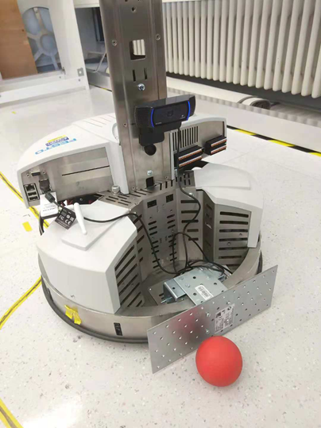
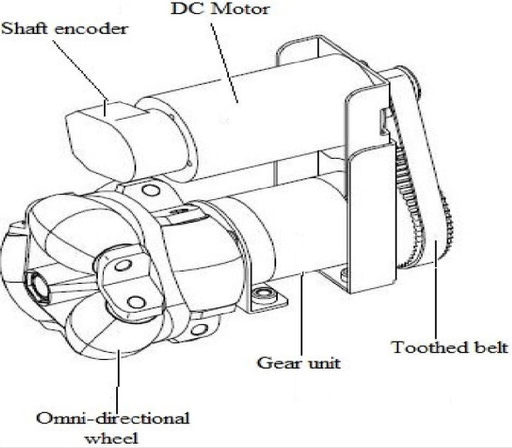
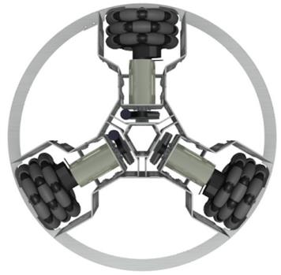
Introduction for Robotino Platform
Hardware introduction
Monocular Web Camera
9 Infrared distance sensors
3 Omnidirectional wheels with DC Motor
Optical rotafy shaft encoder
Promotion: steel bumper for ball kicking
Room 411

Slide 3
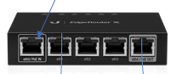
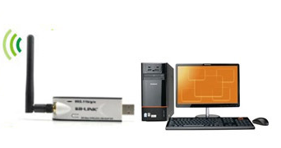

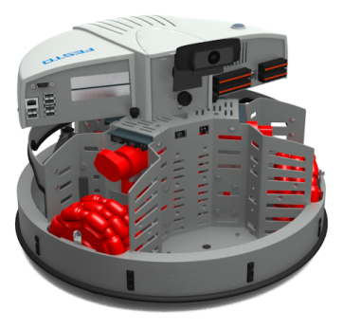
Introduction for Robotino Platform
Distributed architecture based on communication
PC₁
PC₂
PC₃
Robotino 1
Robotino 2
Robotino 3

Slide 4
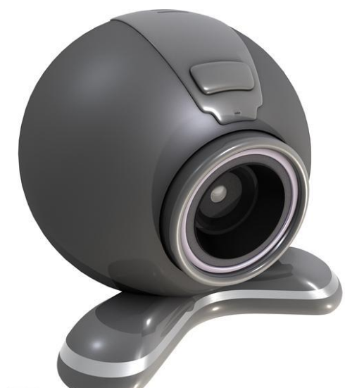

Introduction for Robotino Platform
Distributed architecture based on Camera sensors
PC₁
PC₃
PC₂
Robotino 1
Robotino 3
Robotino 2

Slide 5
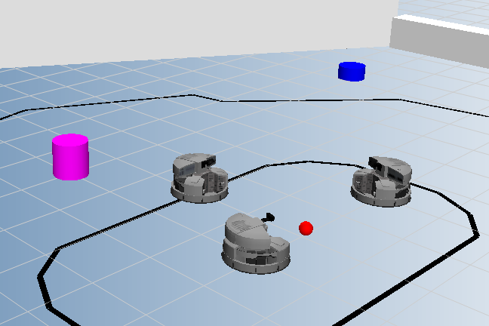
Introduction for Robotino Platform
Software introduction
The Robotino® supports the following programming languages and control systems:
MATLAB/Simulink
C++&OpenCV
JAVA
Net
LabVIEW
ROS (Robot Operating System)
Robotino® View
Robotino® SIM
provides a virtual Robotino in an virtual experimentation environment.
Vitural environment

Slide 6
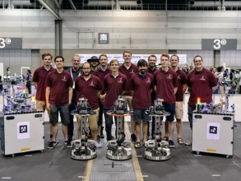
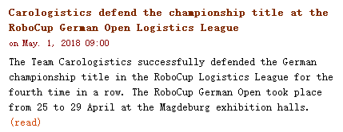
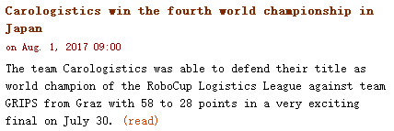
Team: Carologistics
RWTH Aachen University, Germany
RoboCup Logistics League 2017 Final: Carologistics vs. GRIPS
RoboCup Logistics League 2016 Final - Carologistics vs. Solidus

Slide 7
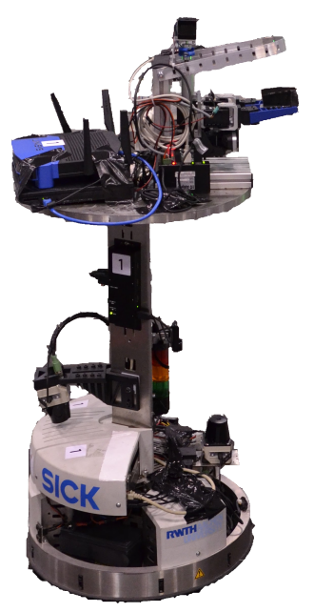
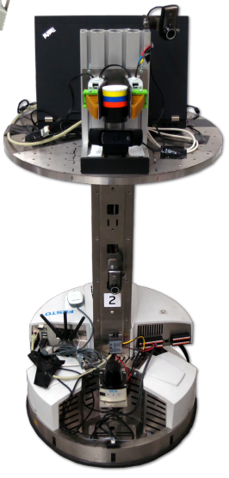
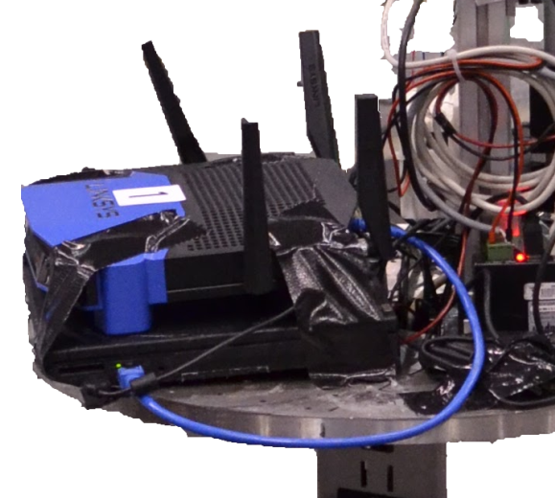
An additional laptop
Increase the computation power
Allow for more elaborate methods
Self-localization
Computer vision
Reasoning
2017
2015

Slide 8
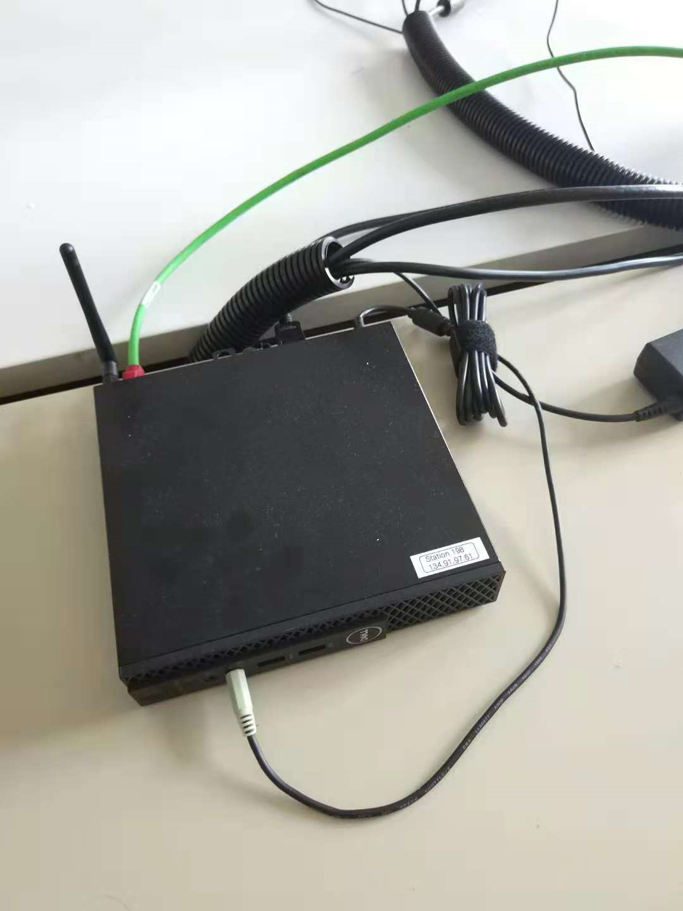
Cable
It is better
Small PC box
Core i5

Slide 9
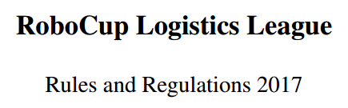
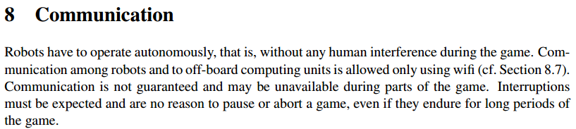
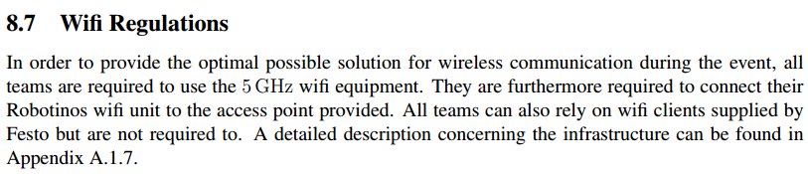

Slide 10
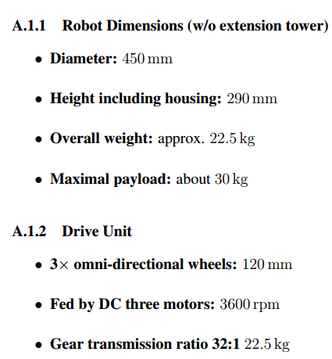
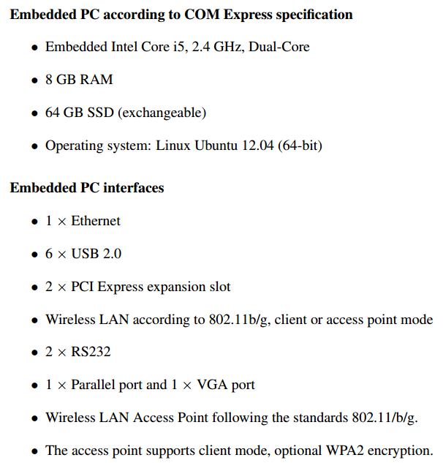

Slide 11
Two real robots
One vitrual robot

Slide 12
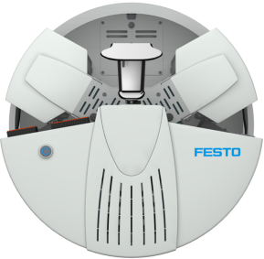
target
1
2
3
1
1
2
3
1
target
3
2
3
2
target

Slide 13
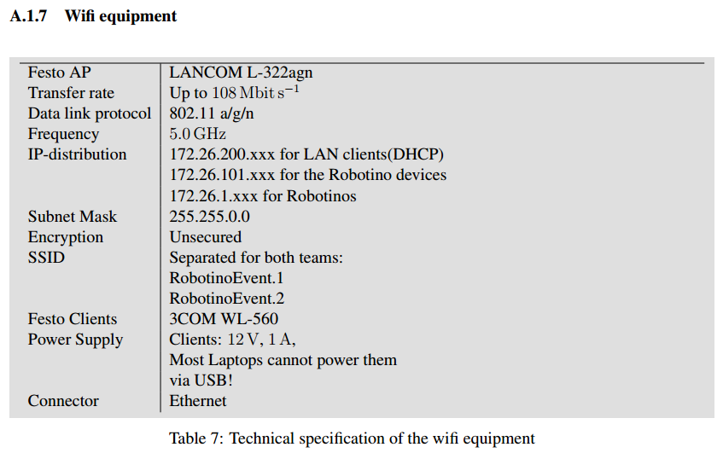

Slide 14
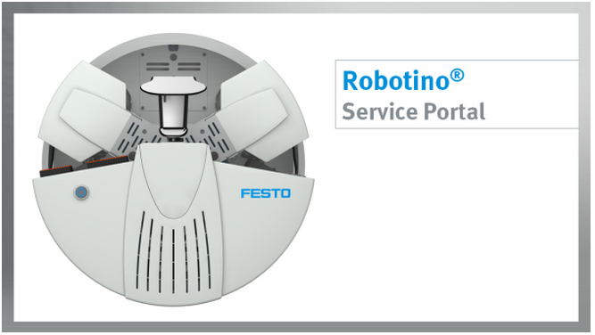
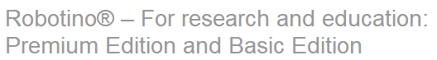
https://www.festo-didactic.com/int-en/services/robotino/?fbid=aW50LmVuLjU1Ny4xNy4zNC4xMTY4
https://www.festo-didactic.com/int-en/learning-systems/education-and-research-robots-robotino/robotino-for-research-and-education-premium-edition-and-basic-edition.htm?fbid=aW50LmVuLjU1Ny4xNy4xOC44NTguODAyNQ

Slide 15
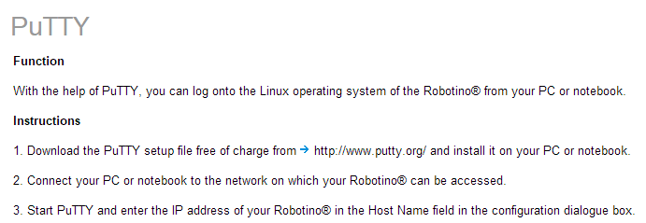
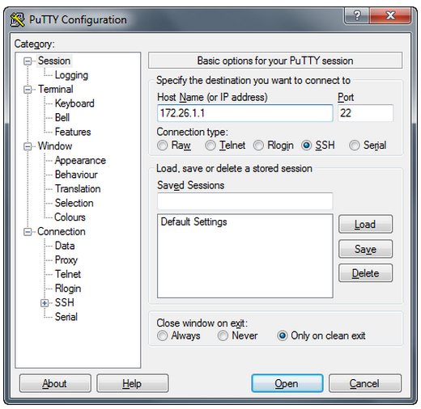
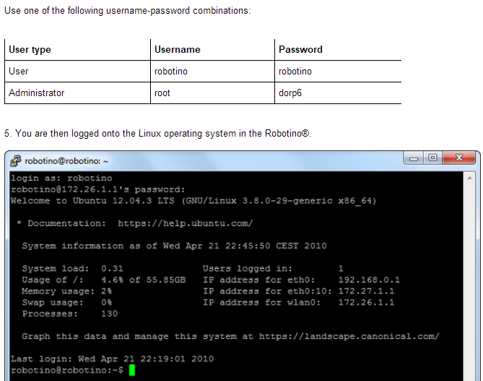

Slide 16
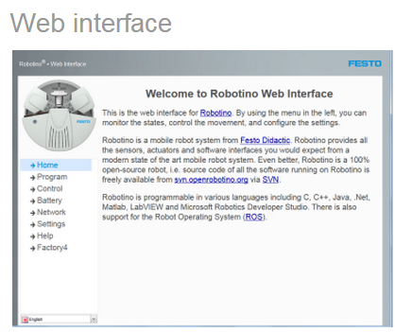
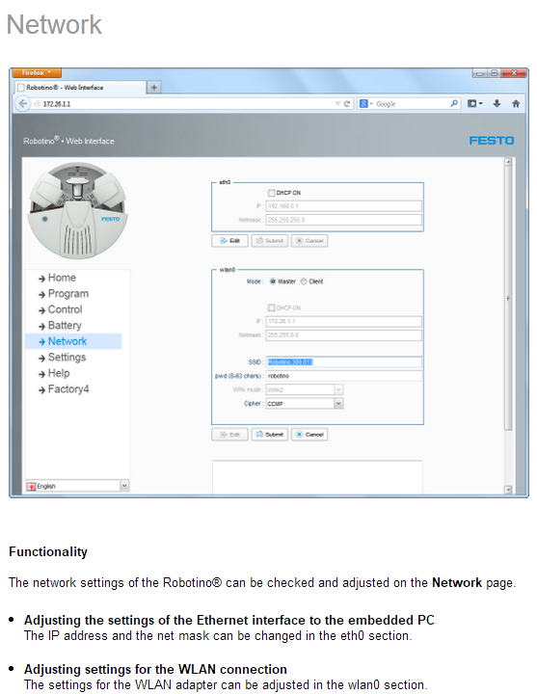
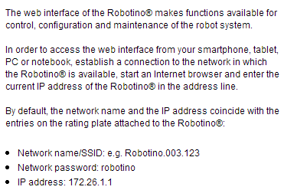

Slide 17
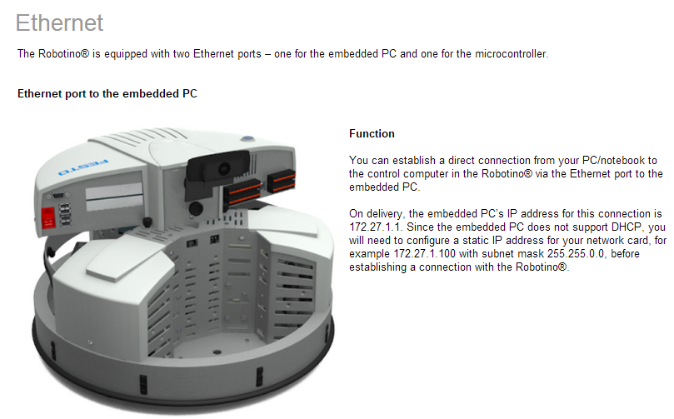

Slide 18
Thank you for your valuable time
and your attention.

